Slide 1

RECOMMENDED TOP TEN APPS
PewDiePie’s Simulator
Geometry Dash Lite
Domino’s Pizza USA
Egg, Inc.
ASOS
The Guardian
Cytus
Fernanfloo
Instagram
Clash of Clans

Slide 2

How Did We Find the Top 10?
Selected only Apps in both Google Play and Apple App stores.
Selected only apps with at least 5000 reviews in either store.
Lifespan of app based on average of rating of both stores.
One app in our recs costs > $1.

Slide 3




Avg. Rating in Half-Stars + 1 = App Lifespan in Years
$1500 Net Income per Month for 12 Months
$18,000
Per Year

Slide 4





Top 10 Apps
#1 PEWDIEPIE’S TUBER SIMULATOR
#2 GEOMETRY DASH LITE
Most subscribed user on Youtube
Reaches over 47 million users and has 13 billion views
Vintage throw-back design appeals to wide audience
Classic side scroll and vintage design make this a popular gaming selection

Slide 5


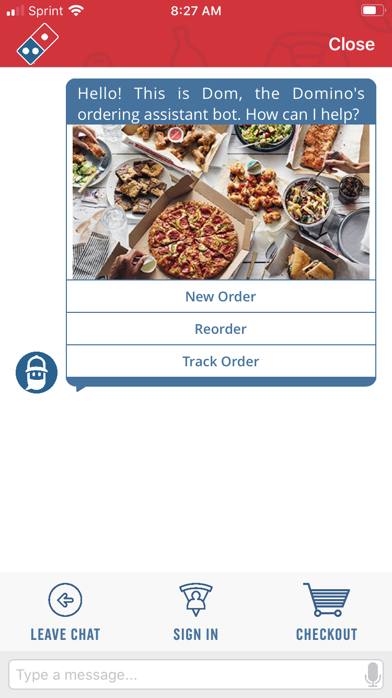
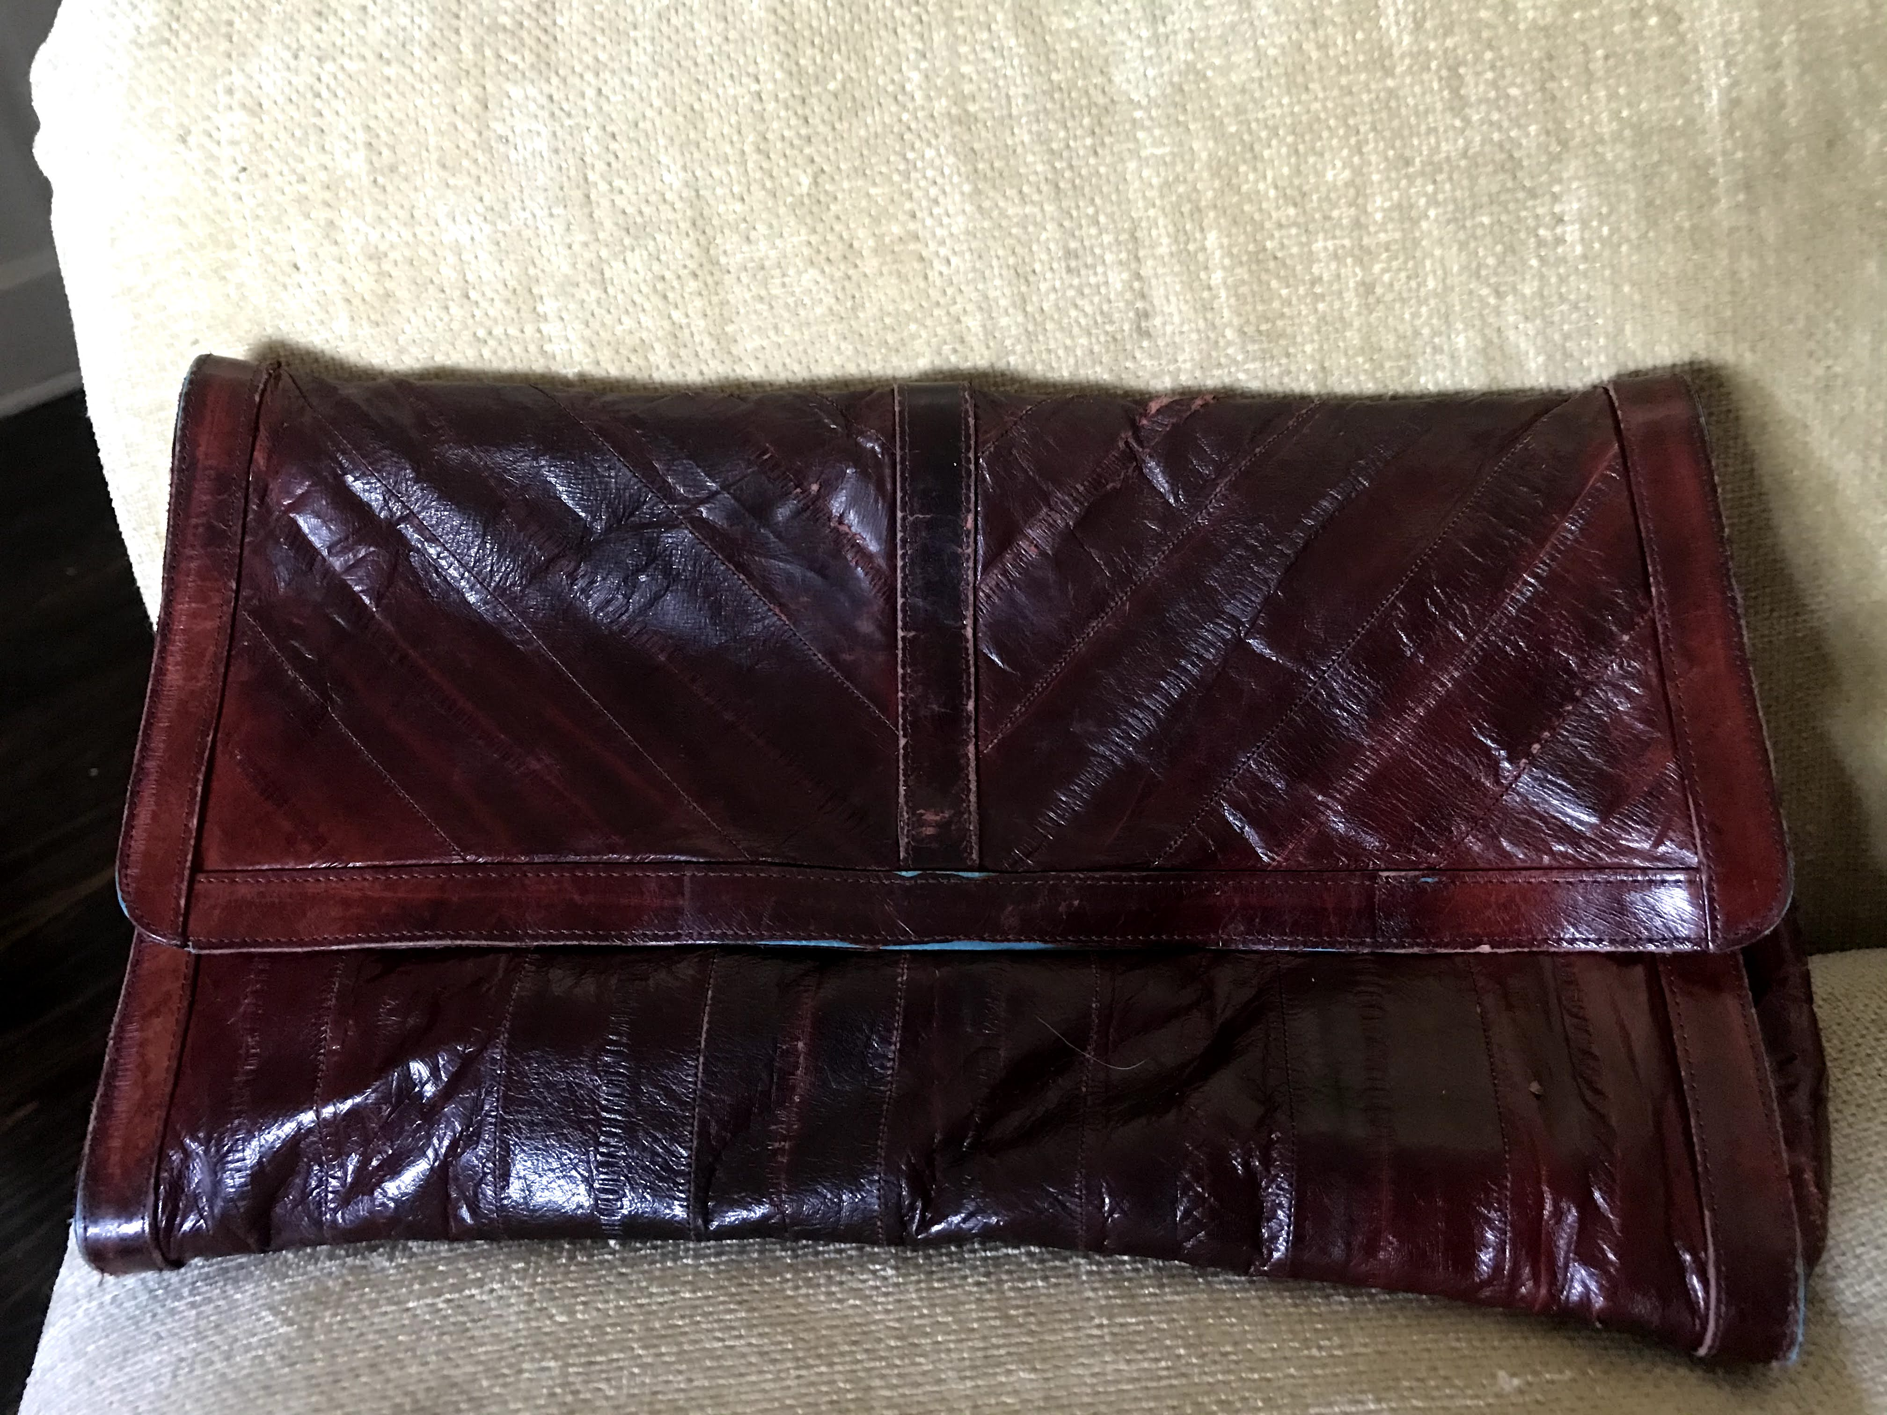

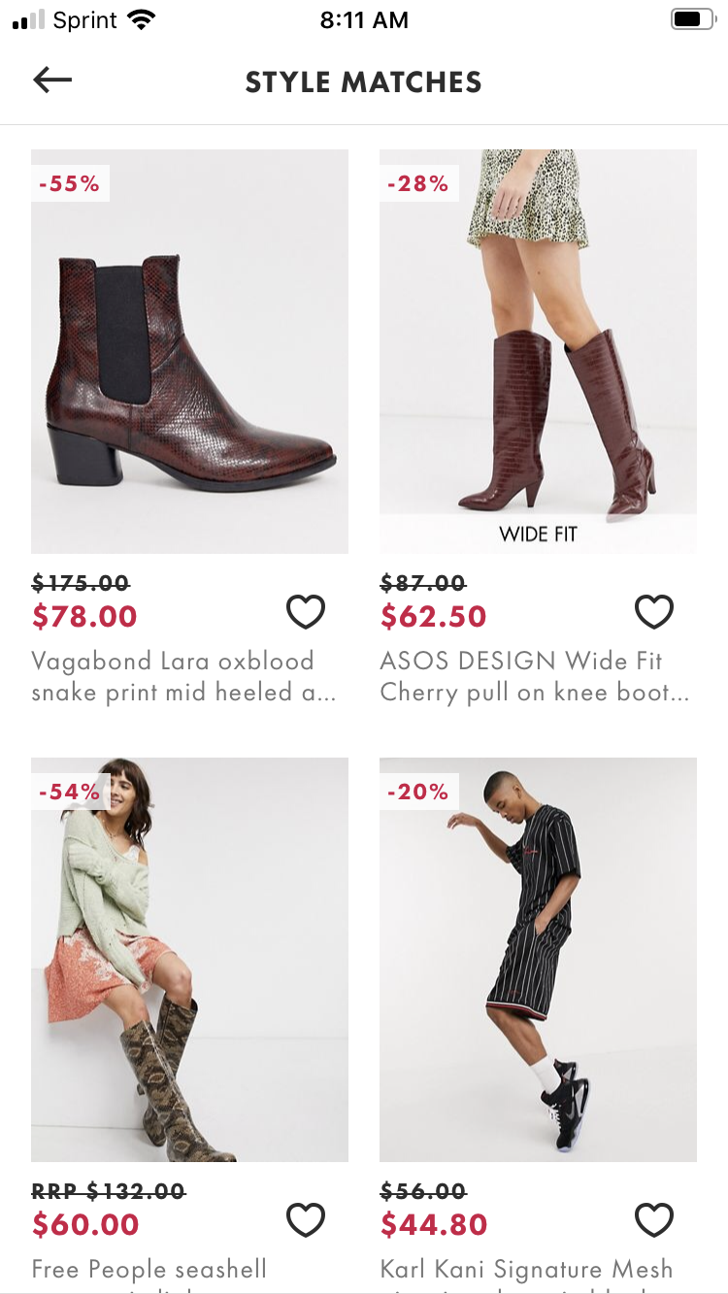

#3 It’s Pizza, It’s Domino’s.
Nostalgia is in and it brought its new best friend to help: Dombot.
#5 ASOS
STYLE MATCH TECHNOLOGY
#4 EGG, inc.
People love pretending to farm!
Take a pic of your favorite clutch…
And ASOS finds your perfect match!

Slide 6


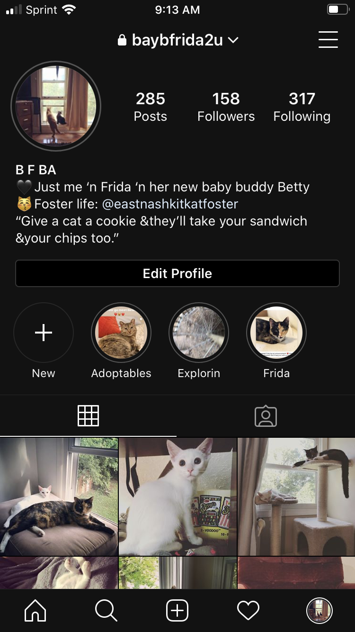


NEWS
GAMES
SOCIAL
GAMES
GAMES

Slide 10



Slide 11
Absurdly Priced Apps – Could These Ever Work for App Trader? (Spoiler: No)
Price | Name | Rating | Review Count | Clout
$399.99 | I am rich | 3.8 | 3547 | 13479
$399.99 | I Am Rich Premium | 4.1 | 1867 | 7655
$0.00 | I AM RICH | 3.9 | 1455 | 5675
$399.99 | I am Rich Plus | 4 | 856 | 3424
$399.99 | ðŸ’Ž I'm rich | 3.8 | 718 | 2728
$18.99 | I am Rich Premium Plus | 4.6 | 459 | 2111
$399.99 | I am rich(premium) | 3.5 | 472 | 1652
$299.99 | I am rich VIP | 3.8 | 411 | 1562
$400.00 | I'm Rich - Trump Edition | 3.6 | 275 | 990
$399.99 | I Am Rich Pro | 4.4 | 201 | 884
$0.00 | i am rich | 3.9 | 213 | 831
$389.99 | I Am Rich | 3.6 | 217 | 781
$399.99 | I am Rich | 4.3 | 180 | 774
$37.99 | I am Rich Person | 4.2 | 134 | 563
$399.99 | I am rich (Most expensive app) | 4.1 | 129 | 529
$399.99 | I am Rich! | 3.8 | 93 | 353
$399.99 | I AM RICH PRO PLUS | 4 | 36 | 144

Slide 12
Highest Average Rating = Longest Lifespan = Most sustainable profit over time

